Slide 1


Slide 2

Alejandro Marcos Díaz
Alejandro Marcos Díaz
3º Ingeniería informática + ADEt
alex99md@gmail.com
Gonzalo Martín Amador
Gonzalo Martín Amador
3º Ingeniería informática + ADEt
gon99martin@gmail.com

Slide 3
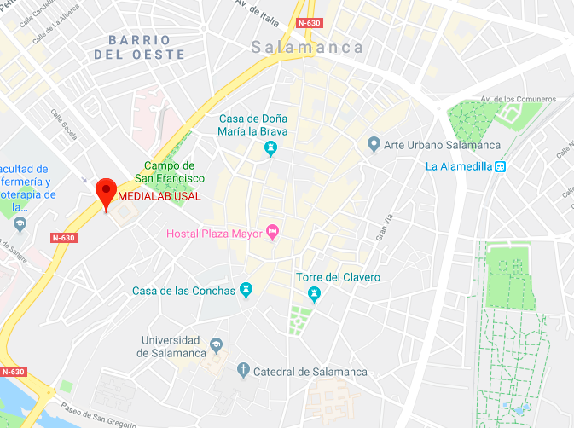
Where are we located?
C/Espejo, 2 – Edificio Multiusos I+D+i

Slide 4


DataLabUSAL
@PydatalabUSAL
@datalabusal

Slide 5
DataLabUSAL
@PydatalabUSAL
@datalabusal

Slide 6
@PydatalabUSAL
DataLabUSAL
@pydatalabusal

Slide 7
@pydatalabusal
@datalabusal

Slide 8

What is DataLab?
Student interdisciplinary group oriented to data analysis and technological applications.
Why should you come to DataLab?
We give you the opportunity to take advantage of your abilities by doing investigation projects and to learn in a pleasant atmosphere.

Slide 9




What did we do last year?

Slide 10
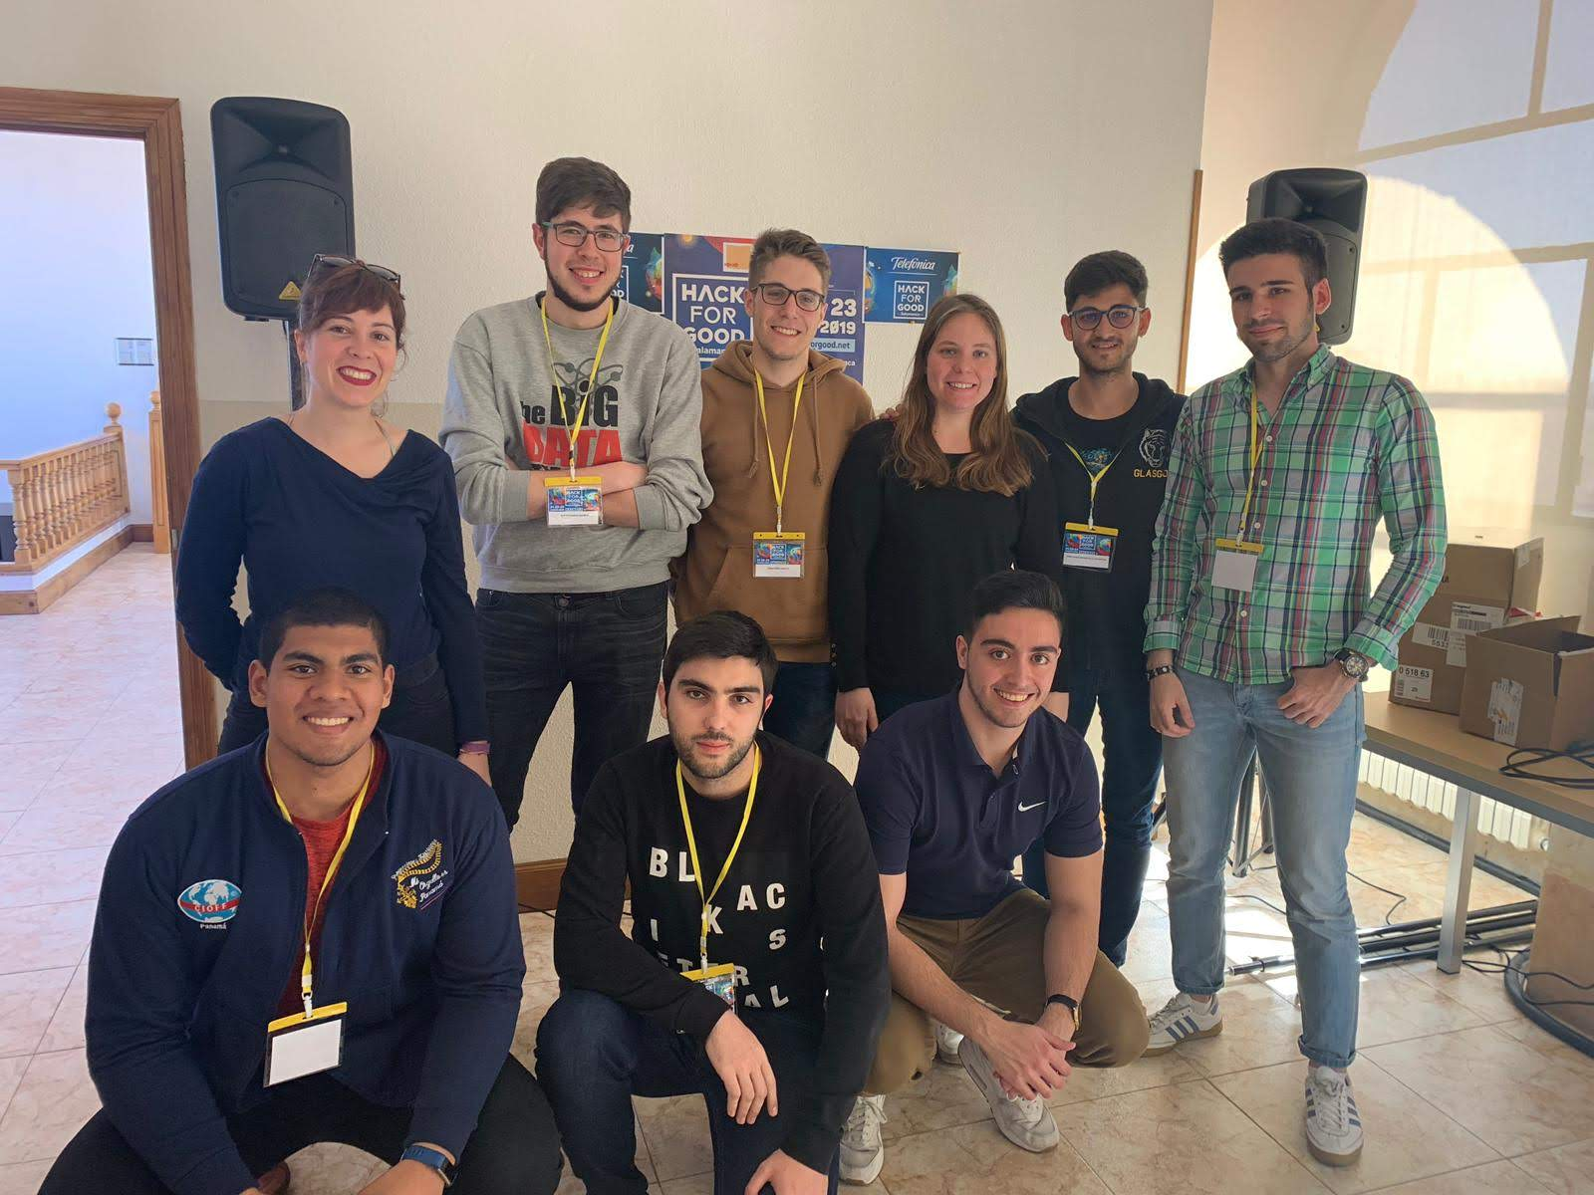
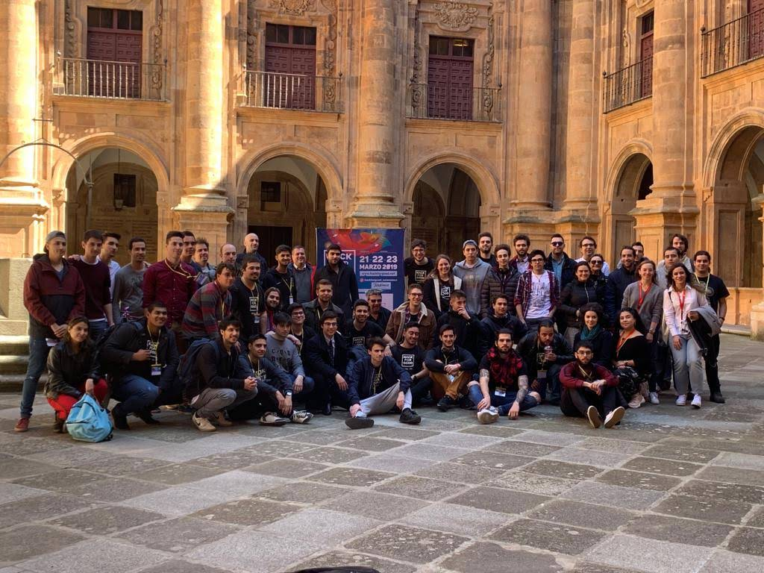

Slide 11
What are our ideas for this year?

Slide 12
What are our ideas for this year?

Slide 13
What are our ideas for this year?

Slide 14
What are our ideas for this year?

Slide 15
1.
1
6
9.
5
1
2

Slide 16
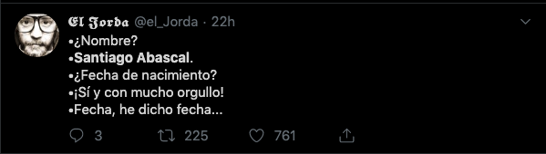
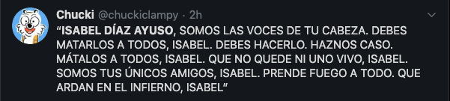
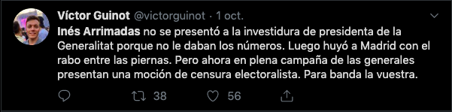

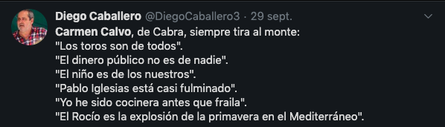

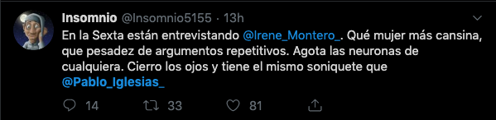
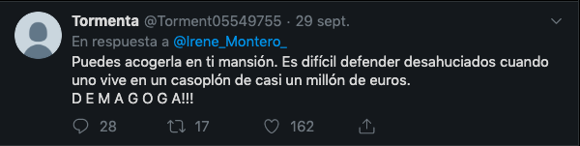
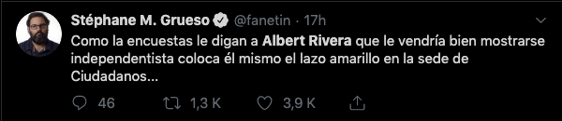
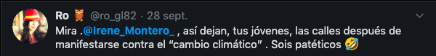
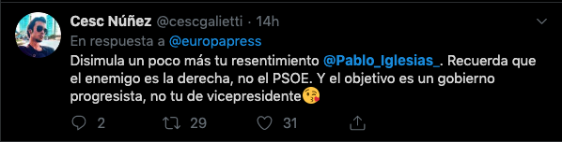
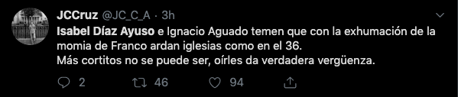
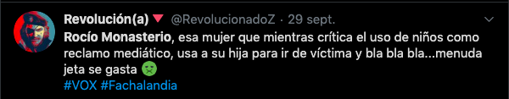
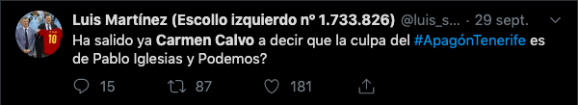

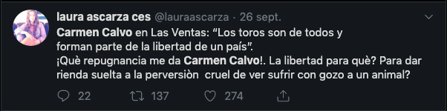


Slide 17


Slide 18
Active learning

Slide 19



Website
Rating
Approval

Slide 20

Natural
Language
Processing

Slide 21
Natural
Language
Processing

Slide 22
Processing
Language
Natural

Slide 24
Applications of NLP
Sentimental analysis
Speech recognition
Authomatic texts translation

Slide 25
Applications of NLP
Authomatic answers to questions (Chatbots)
Documents classification
Text generation
Short random text
LTSMs

Slide 26
Tools we are going to use
¿?

Slide 27
Methodology
1. Corpus analysis
2. Descriptive analysis

Slide 28
Methodology
1. Corpus analysis
2. Descriptive analysis
3. Etiquetado y definición de objetos

Slide 29
Methodology
4. Initial model
5. Improved model
6. Model evaluation
7. Conclusions

Slide 30


Slide 31
First Spanish political tweets corpus
Competitions
Publication
Interdisciplinary

Slide 32

Increased cognitive gains
Increased critical thinking and problema solving skill
Authentic, real life learning
Highly engaging
Highlights learner strenghts
Open doors for people to develop interest in variety of content areas

Slide 33
Increased critical thinking and problem solving skill
Authentic, real life learning
Increased cognitive gains
Increased cognitive gains
Increased critical thinking and problema solving skill
Authentic, real life learning
Highly engaging
Highlights learner strenghts
Open doors for people to develop interest in variety of content areas
Open doors for people to develop interest in variety of content areas
Highly engaging
Highlights learner strenghts

Slide 34



Slide 35
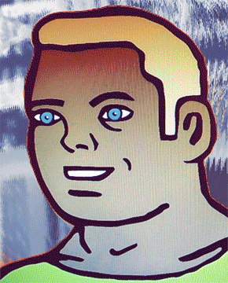


Slide 36
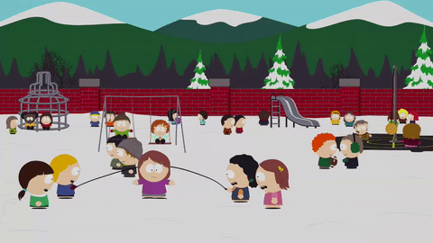

Slide 37
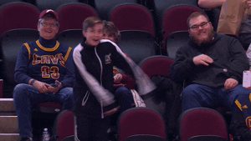

Slide 38


